Slide 1

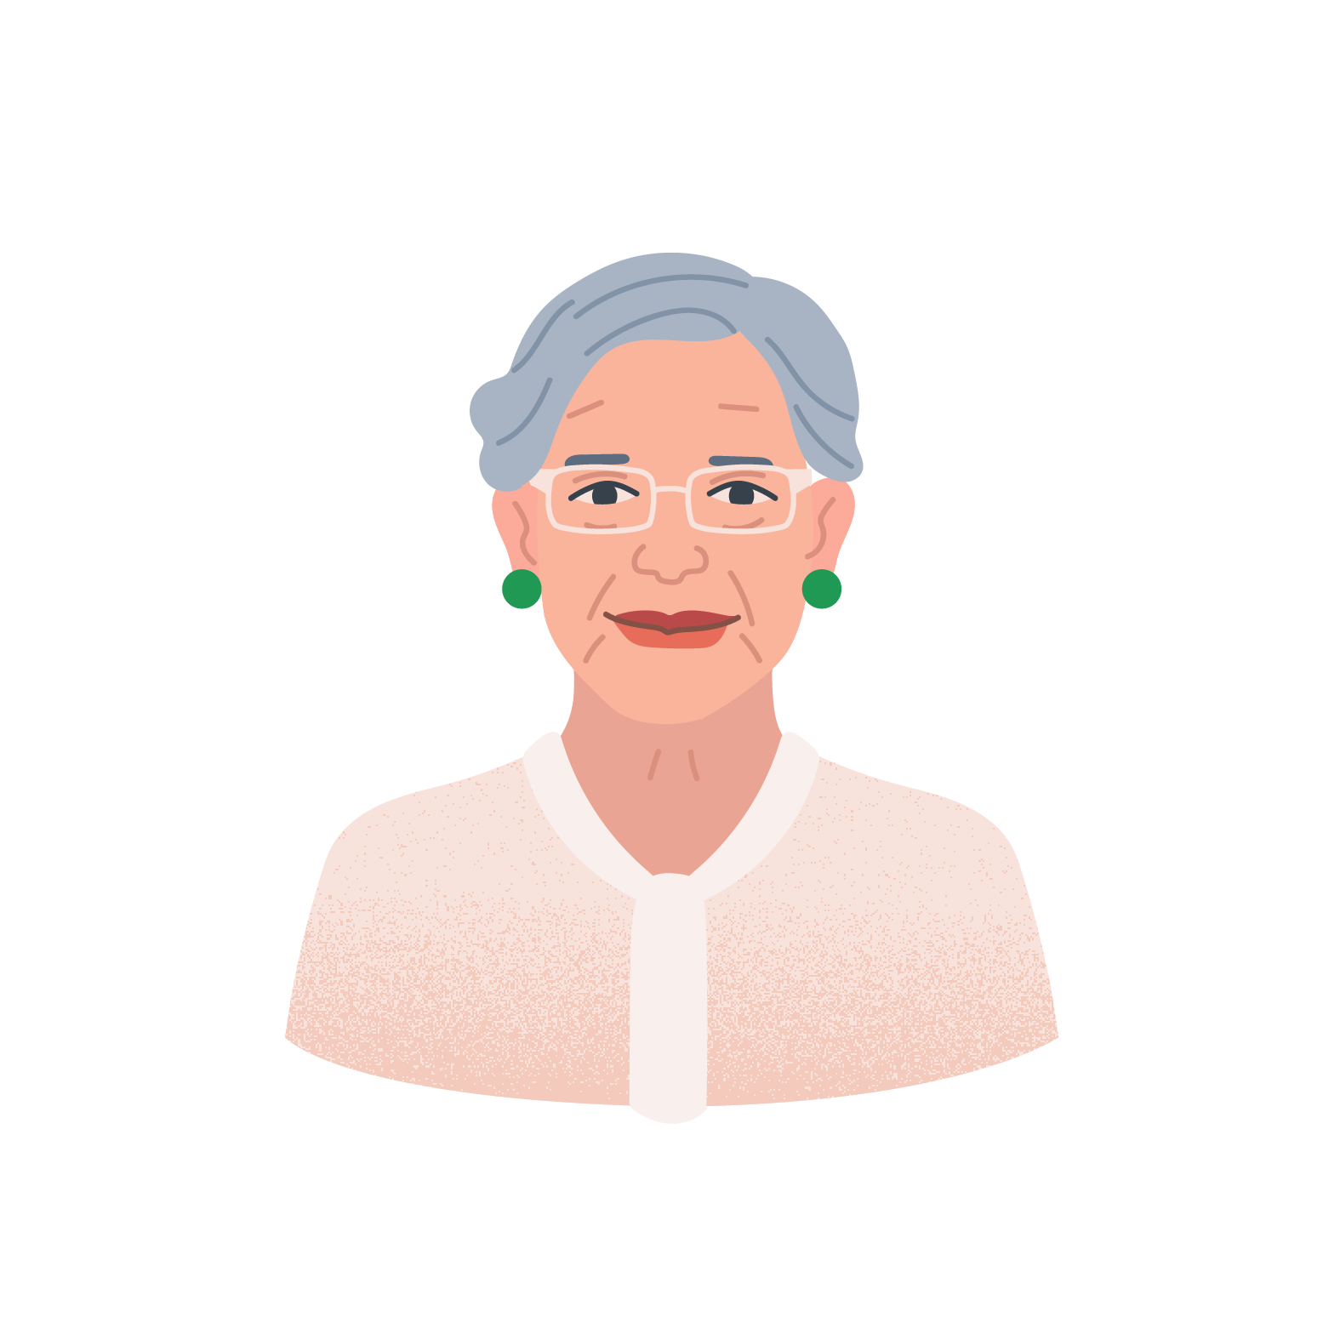

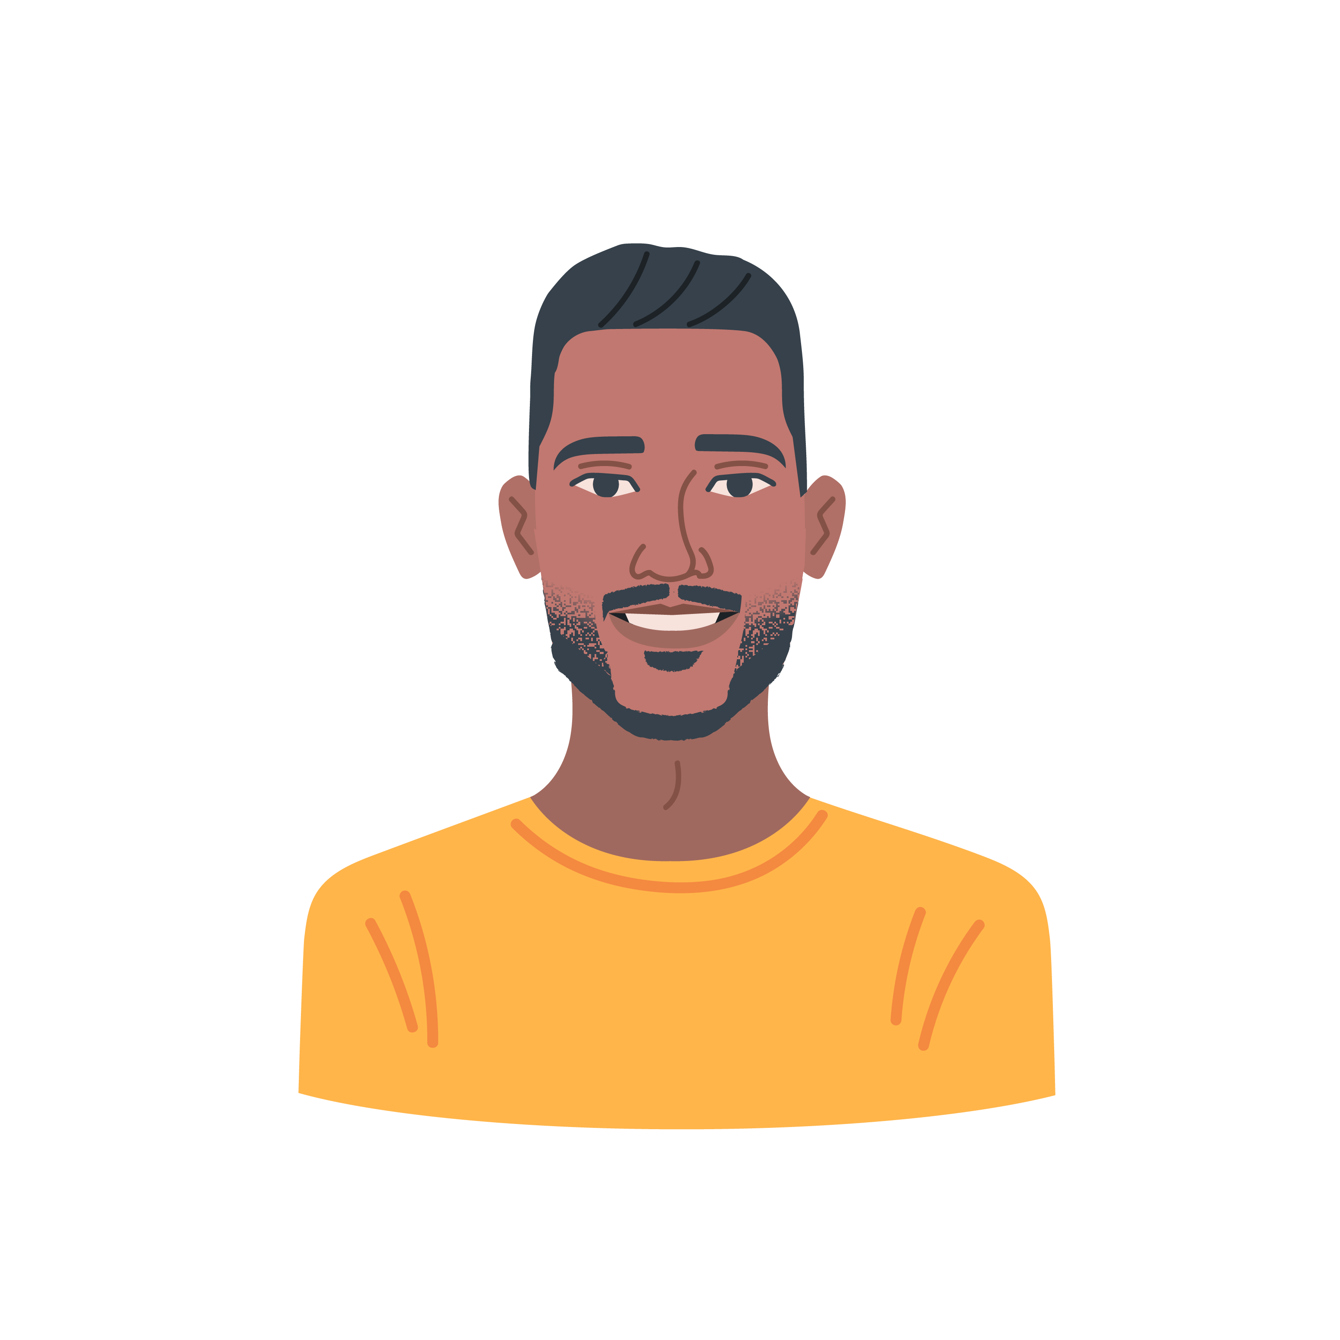
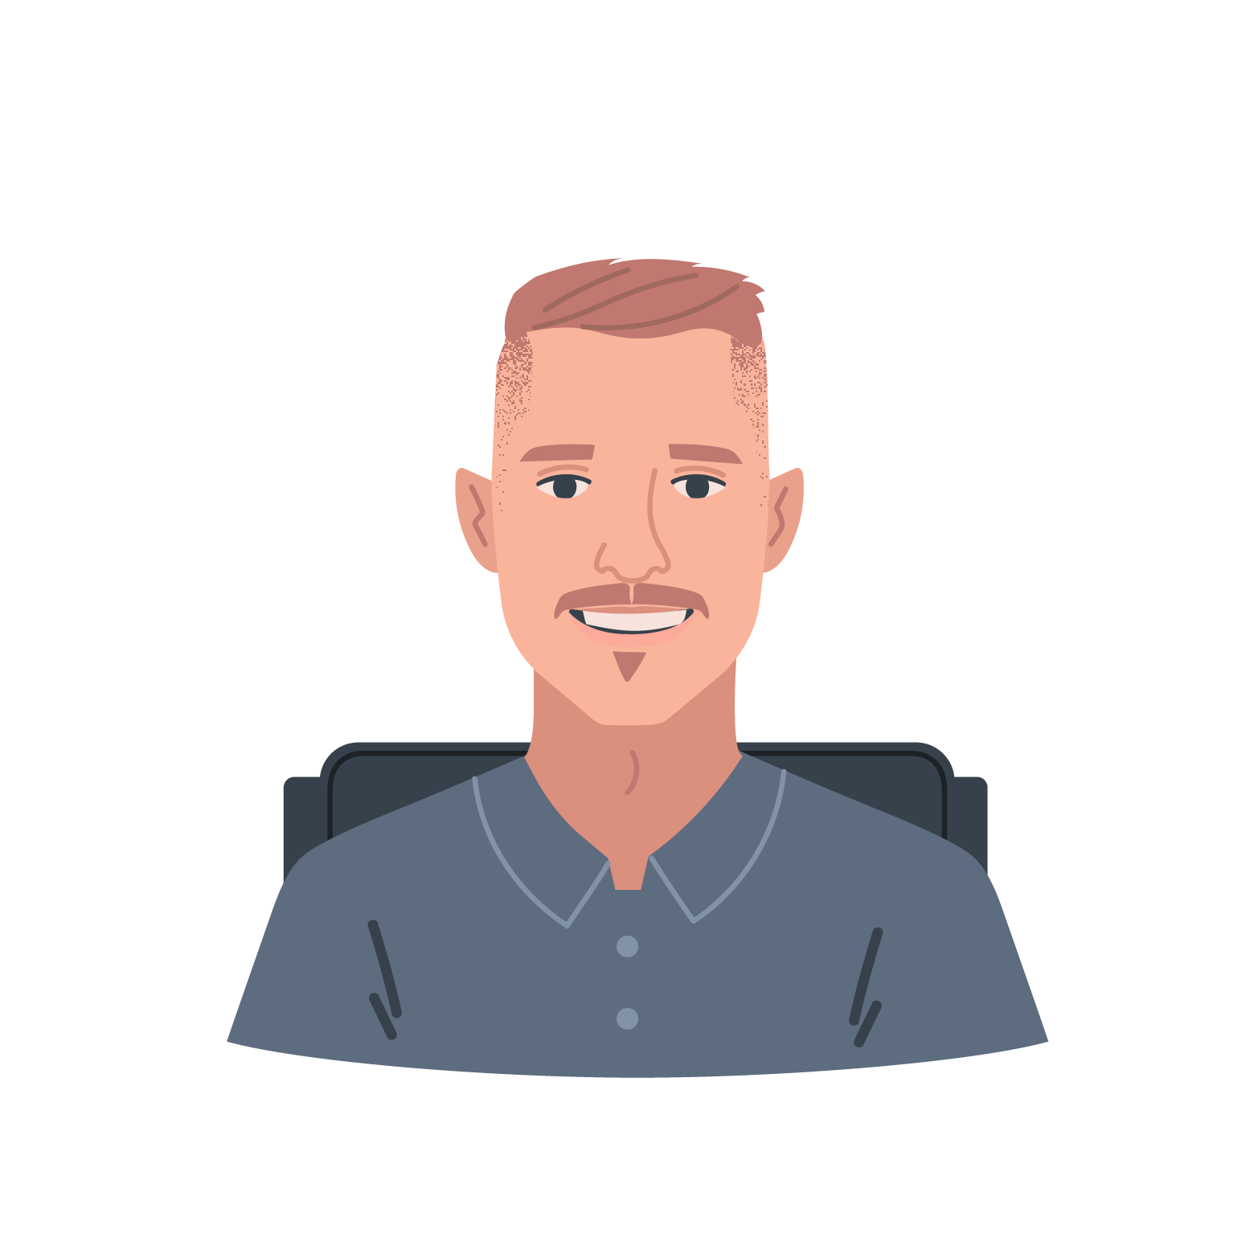
Setting the scene…
Relevant Characteristics
Dermatology consultant with 20+ years of experience
Has concerns about use of AI tools in dermatology
Protected characteristics
Elderly person
Woman
Contextual vulnerability characteristics
Treats a cohort of older patients
Katherine
We are a research team presenting our project and preliminary findings to a board of experts
You are the board of experts!
We are seeking recommendations and support for our next public engagement activities
The next step will be to fine tune our system and promote uptake in the implementation stage
Relevant Characteristics
GP with ~2years experience
Has concerns regarding increased use of technology in primary care
Protected characteristics
Young person
Race
Contextual vulnerability characteristics
Concerned about impact on professional reputation of promoting new technologies
Bijan
Relevant Characteristics
Dermatology consultant
Works in the British Association of Dermatology
Role involves regulating application of AI technologies
Contextual vulnerability characteristics
Concerned about impact on professional reputation of promoting new technologies
Oliver

Slide 2
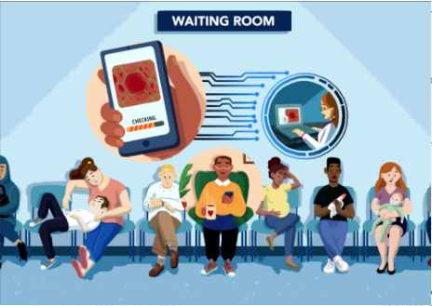
DermaNet Dermatology screening with an AI-based mobile app

Slide 3

Project goals
Artificial Intelligence can offer patients access to expertise and screening in their own time in their own homes.
Challenges:
Patients often face long wait times for GP appointments
GPs face an ever increasing workload
The COVID-19 pandemic limited in person health services
For many individuals, accessing in person healthcare has several barriers
Time off work
Caring responsibilities
Embarrassment

Slide 4
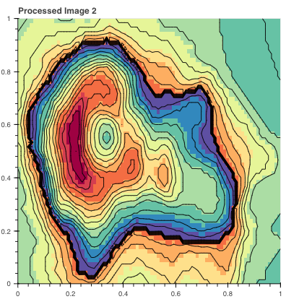
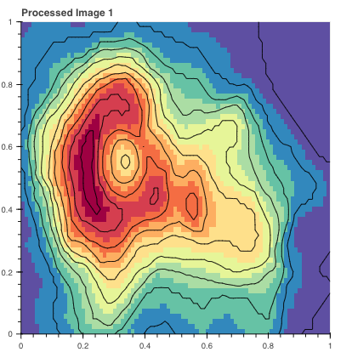
How does the app work?
This app uses Convolutional Neural Network technique
It extracts data from the users in forms of pictures, descriptions, and pain levels including general demographic and comorbidity information
However, the data gets immediately anonymised
Figure: Sample Image Processing

Slide 5
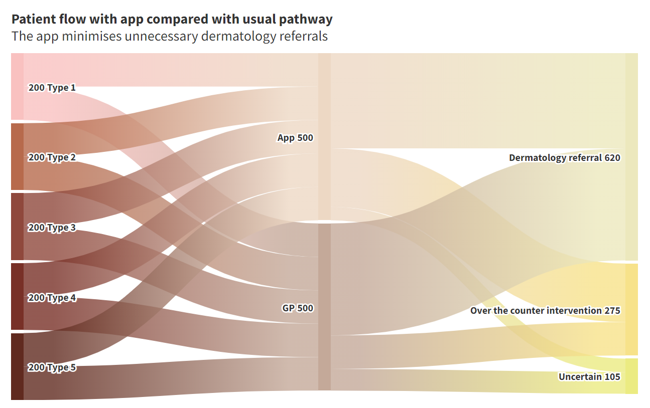
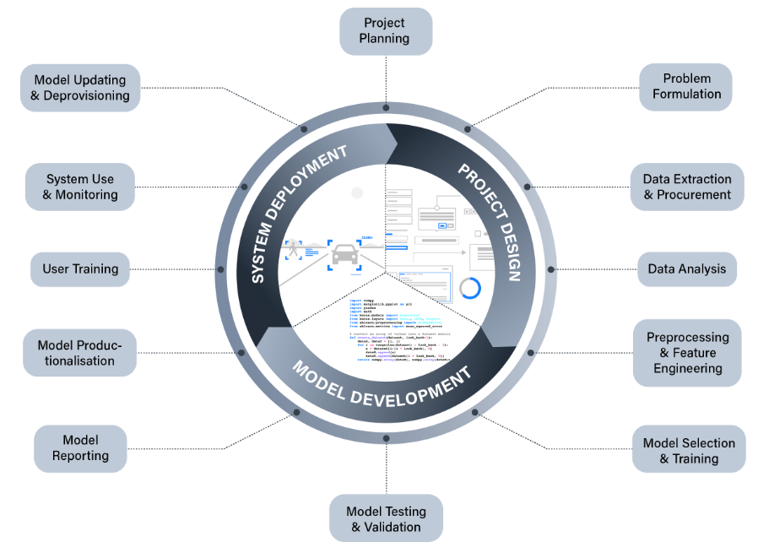
Ethical Challenges
Transparency and Accountability
Embedded bias and inequalities
Trust, legitimacy, and social license

Slide 6
Current Stage
How have we engaged the public so far?
2. Model Development
Community forum to allow the public to ask question on the model being built
Forum set up to allow members of the public to discuss project
3. System Development
Online survey to re access current perception of AI in dermatology
Upcoming Engagement
Public Workshop to review product
1 Project Design
Survey to understand current perception of AI within dermatology
Focus group to address concerns with AI and early thoughts on user requirements

Slide 7
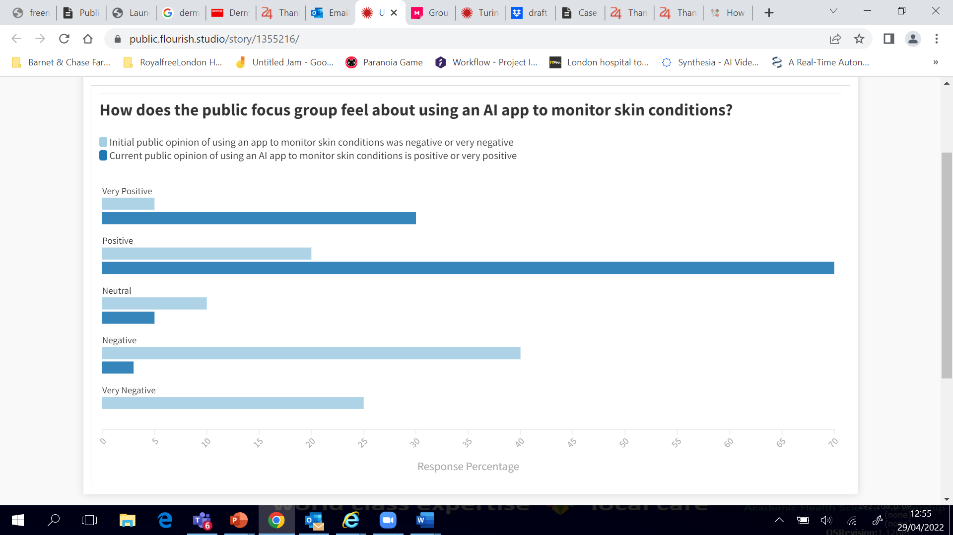
What has been the effect of Public Engagement so far?
How does the public focus group feel about using an AI app to monitor skin conditions?
At project initiation the public had negative opinion on using an AI app to monitor skin conditions
At the current project phase the public have a positive or very positive opinion on using an AI app to monitor skin conditions

Slide 8








Further public engagement
Zeenat
Relevant Characteristics
Used app during testing
Accesses dermatology healthcare through the GP
Care giver- user of healthcare
Protected characteristics
Ethnicity
Religion
Woman
Contextual vulnerability characteristics
Education- lower socio economic
Literacy levels
Social groups
Ethnic minority
Roadblocks
Disruption of treatment/care
Effect relationship with the GP
Not being able to use the technology
Uncomfortable to take photos
Data literacy
Data protection concerns
Enablers
The system could speed up her wait time for accessing healthcare
Improve capacity to care for relative
When
Model Productionalisation
Goals
Public deliberation
Objectives
Improving Social welfare
Establishing Trust, Legitimacy and social licence
Help understand potential barriers and enables to wider implementation
Understand views on ethics within using this app in dermatology care
Views on ensuring equal access to healthcare and how the app can help with that
Ethics and social challenge
How
Reluctancy in using AI in health care including communicating
How to promote equality and not contributing to inequalities
Ethics in communicating uncertainty and confronting bias in data set
Focus group/interactive workshop to consult and partner with patients who have had access to the app
George
Relevant Characteristics
Used app during testing
Low level of digital literacy
Protected characteristics
Elderly person
Disabled person
Contextual vulnerability characteristics
Complex health needs
Social groups
Disabled communities
Roadblocks
May struggle to use app-based system
Mobility issues may make using the system difficult
May be put off by not wanting to lose contact with GP
Enablers
If outcomes are realised, would gain quicker access to care
Alex
Relevant Characteristics
Used app during testing
Understanding of AI
Protected characteristics
Age
Social groups
Young people
Roadblocks
Reluctant to seek healthcare advice
Enablers
Being a technology user and having high level of digital literacy would encourage him to access healthcare via this system
Could become an advocate for use of AI in dermatology
Notes:
Done previous engagement and now we’d like to incorporate it on the model productionalisation or implantation stage.
Read goals and social challenge
From our previous engagement we know that there are still a lot of reluctancy with using AI in health care, particularly with something like dermatology where the bias in the technology has previously been highlighted. We have taken this into consideration with the development of this app. We also know that tech has the availability to advance care but it also has the harm to further segregate groups if the harm and benefits have not fully been considered.
Our wider objectives is to really understand user experience, identify barriers for uptake, what they liked most about it, what were the difficulties of using the app, but also overall views on how to implement new tech into health care including how to alleviate anxieties regarding this
We want to understand how we can encourage not just more users to try it but diverse users to try it. We want this app to help close the inequalities gap in access to care so we want to use this opportunity to understand barriers to uptake across different social groups.
- To do this we know that we need to be able to identify their worries and concerns as well as explain how the app works including communicating uncertainty.
incorporate changes to our user interface as well as our implantation plan.

Slide 9
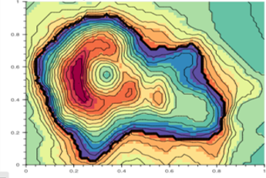






How will we run the public engagement workshop?
In a sample population, the app correctly referred more serious health conditions than the GP
Serious case correctly identified
Serious case incorrectly identified
Data Visualisation of results to demonstrate accuracy of the tool
Allow the public to play around with the AI algorithms to address mistrust in “black boxes”
Exercise to address design elements and help improve the tool for further iteration

